Slide 1

Analyzing the Poker Hand Dataset
Big Data Analytics Project
By Matteo Nestola

Slide 3
Aims of the project
Draw conclusions
Apply 3 ML models to the dataset
Study the type of Classification
Analyzing the dataset
Notes:
Now i stand before you to present the aims and objectives of my BDA project.
Analyzing the Dataset:
To lay a strong foundation, we initiated our project by delving into the depths of my extensive dataset.“
"Data analysis forms the bedrock of the project, as it uncovers valuable insights hidden within the information.“
"Through rigorous data analysis, i aimed to understand the underlying patterns and trends that influence our target variable.”
Study the Type of Classification:
"The core of the project involves studying and understanding the nature of classification within the dataset.“
"By categorizing data points into distinct classes, we can make informed decisions and predictions.“
"The classification study helps us comprehend the intricate relationships between different features and the outcomes they represent.“
Apply 3 ML Models to the Dataset:
"With the data fully comprehended, i proceeded to implement three powerful machine learning models on the dataset.“
“My approach includes the application of five diverse ML models, each offering unique advantages and perspectives.“
"By deploying multiple ML models, i ensure a comprehensive analysis that aids me in making well-rounded conclusions."
Draw Conclusions:
“Analyzing the results in order to draw conclusion.”

Slide 4
SPARK : in particulary Pyspark
Matplotlib
Google Colab
Project tools
Notes:
In this section, i will take a closer look at the powerful tools that played a pivotal role in the project:
Google Colab
Spark
Matplotlib

Slide 5
Google Colab
Google Colab, short for Google Colaboratory, is a cloud-based platform provided by Google that allows users to run and execute Python code in a Jupyter Notebook environment.
It is a free service and provides users with access to a virtual machine (VM) that includes pre-installed Python libraries.
Colab supports the use of GPU and TPU hardware accelerators for computationally intensive tasks, making it particularly useful for machine learning and data analysis tasks.
Notes:
Google Colab provides a user-friendly and efficient platform for working with PySpark by offering a cloud-based environment with free GPU and TPU support, seamless integration with Google Drive, and easy collaboration features. It is an accessible and powerful tool for both beginners and experienced users looking to leverage PySpark for big data analysis and machine learning tasks.

Slide 6
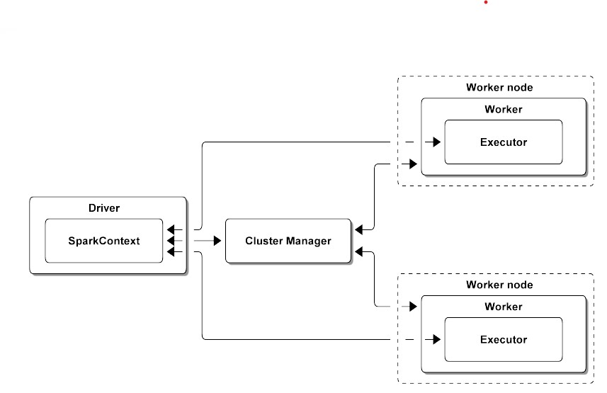
Spark
The idea behind Pyspark is a Cluster computing platform designed for speed and polyvalency.
A Spark application consists of a driver program that coordinates a set of executor processes.
It can works in cluster mode (driver and executors are run on differents nodes) or local mode (driver and executors are run on the same machine).
It provides some API for several languages likes Python
Notes:
“The heart of our project as we shine the spotlight on Apache Spark, a game-changing technology in the world of big data processing.“
"At the core of our data-driven journey lies Apache Spark, a distributed computing engine that revolutionized the way we handle massive datasets."

Slide 7
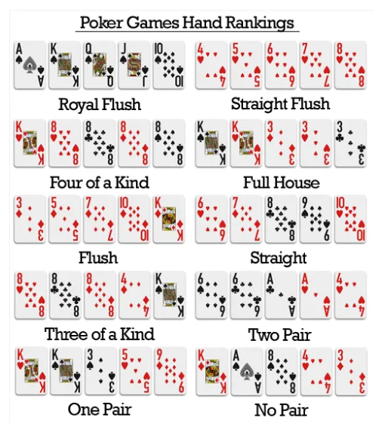
The dataset: Poker Hand Dataset
1. In the game of poker, a "Poker Hand" refers to a set of five cards that a player arranges following the rules of the game. These hands are compared against the hands of other players involved in the showdown to determine the winner of the pot. Each poker hand has a specific ranking or value, and the player with the highest-ranking hand at the end of the round wins the chips or money placed in the pot during that particular hand.
2. Each record is an example of a hand consisting of five playing cards drawn from a standard deck of 52. Each card is described using two attributes (suit and rank), for a total of 10 predictive attributes. There is one Class attribute that describes the “Poker Hand”. The order of cards is important, which is why there are 480 possible Royal Flush hands as compared to 4 .
3. In the dataset, each record represents an example of a poker hand consisting of five playing cards drawn from a standard deck of 52 cards. Each card is described using two attributes: the "suit" attribute, representing the suit of the card (e.g., hearts, diamonds, clubs, spades), and the "rank" attribute, indicating the rank of the card (e.g., 2, 3, 4, ..., 10, Jack, Queen, King, Ace). This results in a total of 10 predictive attributes for each hand.
4. The order of the cards in each hand is crucial in determining the hand's classification. For example, a Royal Flush with the cards in the order of 10, Jack, Queen, King, and Ace would be considered distinct from another Royal Flush with the cards in a different order. This is why there are 480 possible combinations of Royal Flush hands, as each order is counted separately, compared to only 4 distinct combinations of Royal Flush hands in total.
Notes:
The "Poker Hand Dataset" is a fascinating collection of poker hands designed to unravel the complexities of this popular card game. In this dataset, we have records of various poker hands, each consisting of five playing cards drawn from a standard deck of 52. Our goal is to understand the patterns and relationships among these hands, helping us improve our strategic approach and decision-making in poker games.

Slide 8
Project workflow : Intro
Import
Spark Session definition
Analyzing input data
Result evaluations
Preprocessing and Vectorization
Models Definition
Notes:
These set of slides will describe the workflow of the project.

Slide 9
Project workflow: Import and SparkSession
The first step consists in importing the library, in particulary from the pyspark.sql and pyspark.ml
The secon step is define the SparkSession, here are defined the specifics of the Big data platform :
Local or remote mode
The name of the application
Some configuration parameters like the access port

Slide 10
Project workflow: Analysis of the data (1)
The goal of this section is to extract valuable insights from the dataset to enhance our machine learning models.
An important aspect to consider is the distribution of instances along the CLASS column, which serves as our label column.

Slide 11
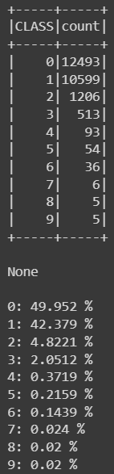
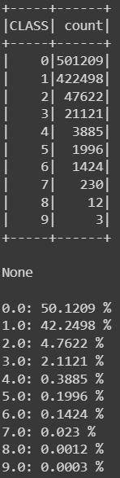
Project workflow: Analysis of the data (2)
TRAIN
TEST
The dataset exhibits class imbalance, indicated by a substantial difference in the number of instances among different labels.
Specifically, there are a significantly larger number of instances labeled 0 and 1 compared to the smaller amount of instances for the remaining labels.

Slide 12
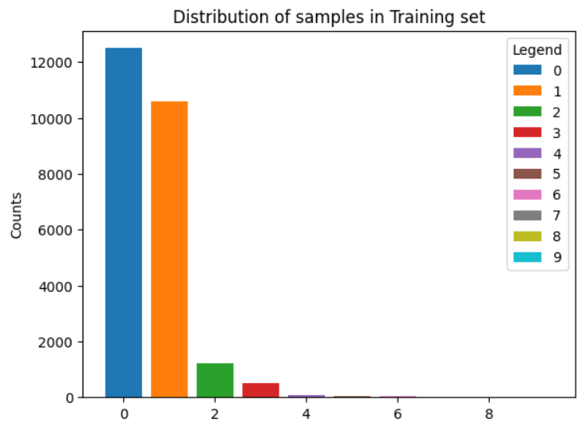
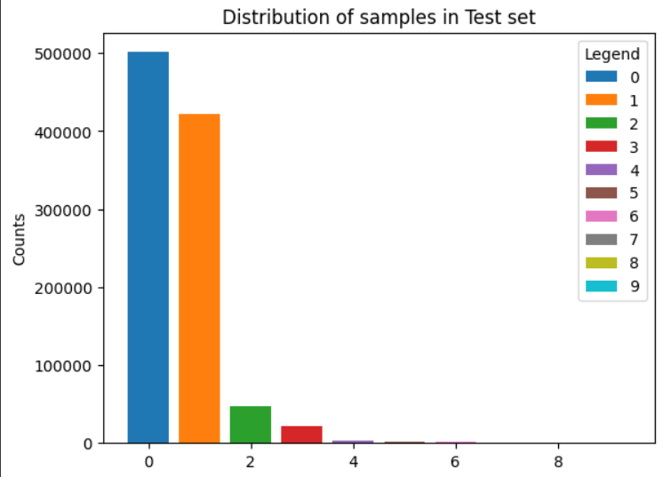

Slide 13
Project workflow: Analysis of the data (3)
Understanding class distribution is crucial for developing accurate models, as imbalanced datasets can lead to biased results and lower performance.
It is essential to address class imbalance to ensure fair representation and improve the effectiveness of our machine learning algorithms.

Slide 14
Project workflow: Analysis of the data (4)
By acknowledging the class distribution imbalance, we can employ various strategies to mitigate its impact on our models.
Potential techniques include oversampling the minority classes, undersampling the majority classes.

Slide 15
Project workflow: Analysis of the data (5)
Balancing the class distribution can help to achieve a more equitable representation of all labels, leading to improved model performance and fairness.
We will further explore these strategies in subsequent sections to optimize our machine learning models for the Poker Hand dataset.

Slide 16
Preprocessing (1)
I tried with oversampling and undersampling in order to augmented the dimension of the minority classes.
The first idea was to oversample the minority class duplicating samples related to it combined with undersampling of the majority class like CLASS 0 and CLASS 1 but this leads to a loss of accuracy in the models results
The second idea was to oversampling the minority class through generating new samples based on permutations because each sample represents a poker hand and swapping the cards into a poker hand represents the same. In order to balance the huge different size between CLASS dimension was foundamental to undersample the major CLASS.
Also this leads to a loss of accuracy in the models results
The third idea was to compute weights based on each class in order to train the models considering the different amount of data associated to each class.

Slide 17
Preprocessing (2)
Enlarging the dataset by unifying the train and test sets, followed by a random split of 0.7 and 0.3.
By combining the train and test datasets, we effectively increase the size of the training data. This enlarged training set enables the model to learn from a more diverse range of examples, potentially leading to improved generalization.
Once the dataset is enlarged, we perform a random split, allocating 70% of the data for training and 30% for testing. The random split ensures a representative distribution of instances across both sets, preserving the original data's characteristics.
The key benefit of this approach lies in its ability to enhance model accuracy. The enlarged and diverse training set empowers the model to learn more effectively, resulting in improved accuracy and performance.
By adopting this methodology, we aim to achieve higher accuracy and bolster the robustness of our machine learning models for the Poker Hand dataset.

Slide 18
Vectorization
In order to simplify the process of preparing data for training machine learning models, several tools can be used:
Vector Assembler
RFormula
It is a class provided by the `pyspark.ml.feature` module that allows you to specify a formula-style string to define a feature transformation pipeline.
A feature transformer that merges multiple columns into a vector column

Slide 19
Definition of models
Decision Tree Classifier
It are versatile and interpretable models used for both classification and regression tasks.
They recursively partition the data into subsets based on feature conditions to create a tree-like structure, where each leaf node represents a class label.
Random Forest Classifier
It is an ensemble learning method that combines multiple decision trees to improve performance and reduce overfitting.
Each decision tree in the Random Forest is trained on a random subset of the data with random feature subsets, ensuring diversity and robustness.
Multi-layer Perceptron Classifier
The Multi-layer Perceptron (MLP) is a type of feedforward neural network that consists of multiple layers of neurons.
MLPs are known for their ability to model complex relationships in data, making them suitable for tasks with non-linear decision boundaries.
It is well-suited for tasks with discrete and continuous features, and it can handle multi-class classification tasks effectively.
It is particularly useful for tasks with high-dimensional datasets and provides better accuracy compared to individual decision trees.
It is capable of handling multi-class classification problems, which can be extended to multi-label classification by using the "one-hot" encoding approach.
PySpark provides a comprehensive set of machine learning algorithms through the pyspark.ml module. These algorithms are designed to handle large-scale datasets and utilize distributed computing capabilities of Spark.

Slide 20
Definition of models
Support Vector Machine
It aims to find the optimal hyperplane that separates different classes by maximizing the margin between the closest data points of different classes.
Gradient Boosted Tree Classifier
GBT is an ensemble learning method that builds multiple decision trees sequentially, where each tree corrects the errors of its predecessor.
PySpark's SVM implementation uses the linear kernel by default, but it also supports other kernel functions for handling non-linearly separable data.
GBT can handle binary classification problems only and is effective in capturing complex relationships in the data.
SVM in PySpark supports Binary Classification only.
It combines the predictions of these weak learners to make final predictions.
PySpark provides a comprehensive set of machine learning algorithms through the pyspark.ml module. These algorithms are designed to handle large-scale datasets and utilize distributed computing capabilities of Spark.

Slide 21
Models: Decision Tree Classifier
Advantage
Simple to understand and interpret; visually represented as a tree structure.
Disadvantage
Prone to overfitting, especially on complex datasets with many levels or deep trees.
Can handle both numerical and categorical data without requiring extensive data preprocessing.
Nonlinear relationships between features and target variable can be captured.
Can be used for both classification and regression tasks.
Struggles with capturing interactions between features.
Sensitive to small changes in the data, leading to high variance.
Too sensitive on unbalanced datasets

Slide 22
Models: Random Forest Classifier
Advantage
Reduces overfitting compared to single decision trees by combining multiple trees.
Disadvantage
More complex than individual decision trees, making it harder to interpret.
Handles large datasets with high dimensionality effectively.
Provides feature importance, allowing for better understanding of feature contributions.
Robust to outliers and noise in the data.
Training time can be longer for large datasets.
Computationally intensive and requires more memory due to the ensemble nature.

Slide 23
Models: Multilayer Perceptron (MLP) Classifier
Advantage
Effective in capturing complex non-linear relationships in the data
Disadvantage
Sensitive to feature scaling and may require normalization or standardization.
Can handle large-scale and high-dimensional datasets.
Capable of learning hierarchical features through multiple layers
Choosing the right architecture (number of layers, neurons) requires experimentation.
Prone to overfitting, especially on small datasets or with insufficient regularization.

Slide 24
Models: Support Vector Machine (SVM) Classifier
Advantage
Effective for high-dimensional data and works well with sparse datasets.
Disadvantage
Computationally expensive, especially for large datasets.
Versatile with different kernel functions for handling non-linear data.
Robust against overfitting when using appropriate regularization.
Memory-efficient since it depends only on support vectors.
May not perform well on highly imbalanced datasets.
Difficult to interpret results with non-linear kernels.

Slide 25
Models: Gradient Boosted Tree (GBT) Classifier
Advantage
Powerful ensemble method capturing complex patterns in the data.
Disadvantage
Handles both binary and multiclass classification tasks.
Provides feature importance, helping interpret the model.
Effective in reducing bias and improving predictive accuracy.
Computationally intensive and may require longer training times for large datasets.
More susceptible to overfitting than single decision trees.
Requires tuning of hyperparameters for optimal performance.

Slide 26
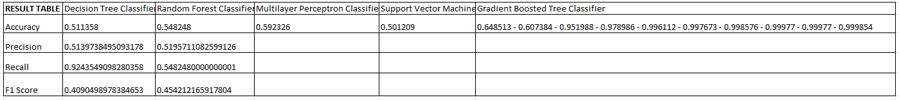
Results
Dataset without preprocessing and without weights
Dataset without preprocessing and weights
Dataset reshape preprocessing and without weights

Slide 27
Conclusions
The analysis of the Poker Hand Dataset using various classification models has revealed that all the tested models produced unsatisfactory results in terms of predictive accuracy (around 50 %).
Several factors may have contributed to the poor performance:
1. Imbalanced Classes: The Poker Hand Dataset might suffer from class imbalance, where some hand categories are underrepresented compared to others. This imbalance can lead the models to focus primarily on the majority class and struggle to effectively predict the minority classes.
2. Inadequate Feature Engineering: The dataset may require additional feature engineering to transform or extract meaningful information from the existing attributes. Without proper feature engineering, the models may not capture the underlying patterns effectively.
3. Lack of Sufficient Data: Insufficient data could be another issue leading to suboptimal results. If the dataset is small or lacks representative samples for certain hand categories, the model will be less accurate.

Slide 28
Conclusions
4. Insensitive to Linear Separation: Some models, like LinearSVC, might not perform well on the Poker Hand Dataset if the data cannot be linearly separated, as this model relies on finding linear decision boundaries.
5. Model Hyperparameter Tuning: The models' suboptimal performance might also be attributed to insufficient hyperparameter tuning. Finding the best combination of hyperparameters for each model is crucial for achieving better results.
6. Overfitting: Some models, especially complex ones like Random Forest and Gradient Boosted Trees, are prone to overfitting if not carefully tuned or regularized. Overfitting occurs when models memorize the training data but fail to generalize on unseen data.els may struggle to generalize well on unseen data.

